Slide 1
Computer Organization and Design Performance
Montek Singh
Jan 13, 2016
Lecture 2

Slide 2
Topics
Defining “Performance”
Performance Measures
How to improve performance
Performance pitfalls
Examples

Slide 3
Why Study Performance?
Helps us make intelligent design choices
See through the marketing hype
Key to understanding underlying computer organization
Why is some hardware faster than others for different programs?
What factors of system performance are hardware related?
e.g., Do we need a new machine …
… or a new operating system?
How does a machine’s instruction set affect its performance?

Slide 4
What is Performance?
Loosely:
How fast can a computer complete a task
Examples of “tasks”:
Short tasks:
Crunch a bunch of numbers (say calculate mean)
Display a PDF document
Respond to a game console button press
Longer ones:
Search for a document on hard drive
Rip a CD track into an mp3 file
Apply a Photoshop filter
Transcode/recode a video

Slide 5
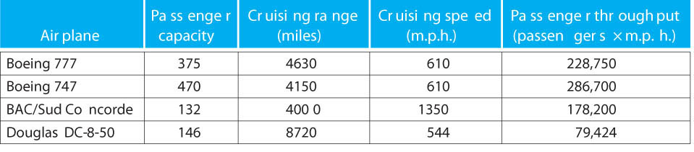
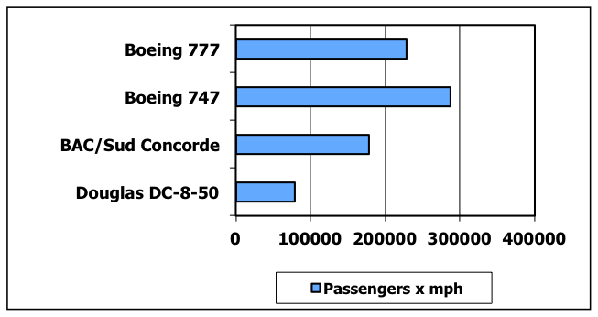
Which airplane is “best”?
Airplane
Passenger capacity
Cruising range (miles)
Cruising speed (mph)
Passenger throughput (passengers x mph)

Slide 6
Which airplane is “best”?
Airplane
Passenger capacity
Cruising range (miles)
Cruising speed (mph)
Passenger throughput (passengers x mph)
How much faster is the Concorde than the 747?
2.2 X (“X” means “factor of”)
How much larger is the 747’s capacity than the Concorde?
3.6 X
It is roughly 4000 miles from Raleigh to Paris. What is the throughput of the 747 in passengers/hr? The Concorde?
What is the latency (trip time) of the 747? The Concorde?
6.56 hours, 2.96 hours

Slide 7
Performance Metrics
Latency: Time from input to corresponding output
How long does it take for my program to run?
How long must I wait after typing return for the result?
Other examples?
Throughput: Results produced per unit time
How many results can be processed per second?
What is the average execution rate of my program?
How much work is getting done each second?
Other examples?

Slide 8
Design Tradeoffs
Performance is rarely the sole factor
Cost is important too
Energy/power consumption is often critical
Frequently used compound metrics
Performance/Cost (throughput/$)
Performance/Power (throughput/watt)
Work/Energy (total work done per joule)
for battery-powered devices

Slide 9
Execution Time
Elapsed Time/Wall Clock Time
counts everything (disk and memory accesses, I/O, etc.)
includes the impact of other programs
a useful number, but often not good for comparison purposes
CPU time
does not include I/O or time spent running other programs
can be broken up into system time, and user time
Our focus: user CPU time
time spent executing actual instructions of “our” program

Slide 10
Performance
For some program running on machine X,
Performance_{X} = Program Executions / Time_{X} (executions/sec)
= 1 / Execution Time_{X}
Relative Performance
"X is n times faster than Y”
Performance_{X} / Performance_{Y} = n
Example:
Machine A runs a program in 20 seconds
Machine B runs the same program in 25 seconds
By how much is A faster than B?
By how much is B slower than A?
Performance_{A} = 1/20
Performance_{B} = 1/25
Machine A is (1/20)/(1/25) = 1.25 times faster than Machine B

Slide 11
Performance: Pitfalls of using %
Same Example:
Machine A runs a program in 20 sec; B takes 25 sec
By how much is A faster than B?
Is it (25-20)/25 = 20% faster?
Is it (25-20)/20 = 25% faster?
Correct answer is: A is (Perf_{A}-Perf_{B})/Per_{B} faster
(0.05 - 0.04) / (0.04) = 25% faster
By how much is B slower than A?
Correct answer is: B is (Perf_{B}-Perf_{A})/Per_{A} faster/slower
(0.04 - 0.05) / (0.05) = -20% faster = 20% slower
Confusing: A is 25% faster than B; B is 20% slower
Better: A is 1.25 times faster than B; B is 1/1.25 as fast
Also: %ages are only good up to 100%
Never say A is 13000% faster than B

Slide 12
CPU Clocking
Operation of digital hardware governed by a constant-rate clock
Clock period
Clock (cycles)
Data transfer and computation
Update state
Clock period: duration of a clock cycle
e.g., 250ps = 0.25ns = 250×10^{–12}s
Clock frequency (rate): cycles per second
e.g., 1/(0.25ns) = 4GHz = 4000MHz = 4.0×10⁹Hz

Slide 13
Program Clock Cycles
Instead of reporting execution time in seconds, we often use clock cycle counts
Why? A newer generation of the same processor…
Often has the same cycle counts for the same program
But often has different clock speed (ex, 1 GHz changes to 1.5 GHz)
Clock “ticks” indicate when machine state changes
an abstraction: allows time to be discrete instead of continuous
Simple relation:
time

Slide 14
Program Clock Cycles
Relation:
or:
cycle time = time between ticks = seconds per cycle
clock rate (frequency) = cycles per second (1 Hz = 1 cycle/s)
A 200 MHz clock has a cycle time of:

Slide 15
Instruction Count and CPI
Instruction Count for a program
Determined by
program
Instruction set architecture (ISA)
compiler
Average cycles per instruction (“CPI”)
Determined by CPU hardware
If different instructions have different CPI
Average CPI affected by instruction mix

Slide 16
Computer Performance Measure
Millions of Instructions per Second
Frequency in MHz
Unfortunate coincidence:
This “MIPS” has nothing to do with the name of the MIPS processor we will be studying!
CPI (Average Clocks Per Instruction)
Historically:
PDP-11, VAX, Intel 8086: CPI > 1
Load/Store RISC machines MIPS, SPARC, PowerPC, miniMIPS: CPI = 1
Modern CPUs, Pentium, Athlon : CPI < 1

Slide 17
How to Improve Performance?
Many ways to write the same equations:
So, to improve performance (everything else being equal) you can either
________ the # of required cycles for a program;
________ the clock cycle time or, said another way,
________ the clock rate;
________ the CPI (average clocks per instruction).
MIPS Pitfall
Cannot compare MIPS of two different processors if they run different sets of instructions!
➔ Meaningless Indicator of Processor Speed!
Decrease
Decrease
Increase
Decrease

Slide 18
How Many Cycles in a Program?
For some processors (e.g., MIPS processor)
# of cycles = # of instructions
1st instruction
2nd instruction
3rd instruction
4th
5th
6th
...
time
This assumption can be incorrect, Different instructions take different amounts of time on different machines.
Memory accesses might require more cycles than other instructions.
Floating-Point instructions might require multiple clock cycles to execute.
Branches might stall execution rate
Notes:
Each instruction can generally be done in one clock cycle in a MIPS processor, but not always

Slide 19
Example
Our favorite program runs in 10 seconds on computer A, which has a 2 GHz clock. We are trying to help a computer designer build a new machine B, to run this program in 6 seconds. The designer can use new (or perhaps more expensive) technology to substantially increase the clock rate, but has informed us that this increase will affect the rest of the CPU design, causing machine B to require 1.2 times as many clock cycles as machine A for the same program. What clock rate should we tell the designer to target?

Slide 20
Now that we understand cycles
A given program will require
some number of instructions (machine instructions)
some number of cycles
some number of seconds
We have a vocabulary that relates these quantities:
cycle time (seconds per cycle)
clock rate (cycles per second)
CPI (average clocks per instruction)
a floating point intensive application might have a higher CPI
MIPS (millions of instructions per second)
this would be higher for a program using simple instructions

Slide 21
Performance Traps
Performance is determined by the execution time of a program that you care about.
Do any of the other variables equal performance?
# of cycles to execute program?
# of instructions in program?
# of cycles per second?
average # of cycles per instruction?
average # of instructions per second?
Common pitfall:
Thinking that only one of the variables is indicative of performance when it really is not!

Slide 22
CPI Example
Suppose we have two implementations of the same instruction set architecture (ISA)
If two machines have the same ISA which quantity (e.g., clock rate, CPI) is the same?
For some program:
Computer A has a clock cycle time of 250 ps and a CPI of 2.0
Computer B has a clock cycle time of 500 ps and a CPI of 1.2
What machine is faster for this program, and by how much?
A is faster by 1.2 X

Slide 23
CPI in More Detail
If different instruction classes take different numbers of cycles
Weighted average CPI:
Relative frequency

Slide 24
Example: Compiler’s Impact
Two different compilers are being tested for a 500 MHz machine with three different classes of instructions: Class A, Class B, and Class C, which require one, two, and three cycles (respectively). Both compilers are used to produce code for a large piece of software. The first compiler's code uses 5 million Class A instructions, 1 million Class B instructions, and 2 million Class C instructions. The second compiler's code uses 7 million Class A instructions, 1 million Class B instructions, and 1 million Class C instructions.
Which program uses fewer instructions?
Instructions₁ = (5+1+2) x 10⁶ = 8 x 10⁶
Instructions₂ = (7+1+1) x 10⁶ = 9 x 10⁶
Which sequence uses fewer clock cycles?
Cycles₁ = (5(1)+1(2)+2(3)) x 10⁶ = 13 x 10⁶
Cycles₂ = (7(1)+1(2)+1(3)) x 10⁶ = 12 x 10⁶
CPI₁ = ?
13/8 = 1.625
CPI₂ = ?
12/9 = 1.33

Slide 25
CPI Example
Alternative compiled code versions using instructions in classes A, B, C
Class | A | B | C
CPI for class | 1 | 2 | 3
IC for version 1 | 2 | 1 | 2
IC for version 2 | 4 | 1 | 1
Version 1: IC = 5
Clock Cycles = 2×1 + 1×2 + 2×3 = 10
Avg. CPI = 10/5 = 2.0
Version 2: IC = 6
Clock Cycles = 4×1 + 1×2 + 1×3 = 9
Avg. CPI = 9/6 = 1.5

Slide 26
Performance Summary
The BIG Picture
Performance depends on
Algorithm: affects IC, possibly CPI
Programming language: affects IC, CPI
Compiler: affects IC, CPI
Instruction set architecture: affects IC, CPI, Cycle Time

Slide 27
Benchmarks
Performance best determined by running a real application
Use programs typical of expected workload
Or, typical of expected class of applications
e.g., compilers/editors, scientific applications, graphics, etc.
Small benchmarks
nice for architects and designers
easy to standardize
can be abused
SPEC (System Performance Evaluation Cooperative)
companies have agreed on a set of real program and inputs
can still be abused
valuable indicator of performance (and compiler technology)

Slide 28
SPEC ’95
Periodically updated with newer benchmarks
SPEC 2000, SPEC 2006

Slide 29
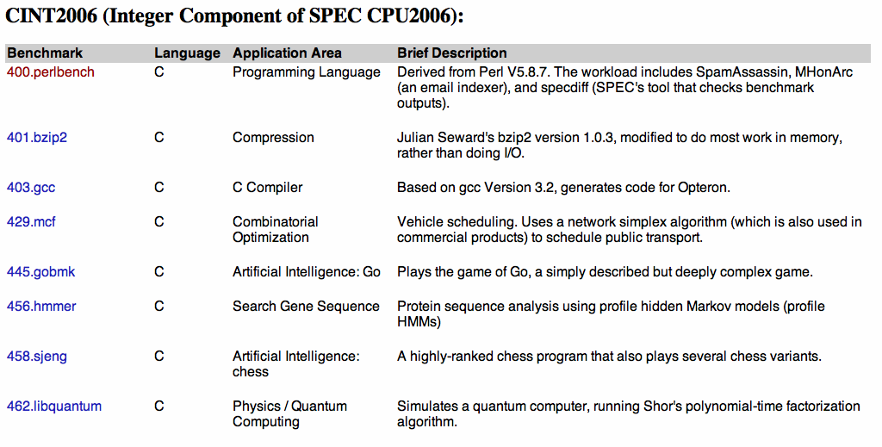
SPEC 2006
Interesting to see how the mix of applications has changed over the years…
See http://www.spec.org/cpu2006/{CINT2006, CFP2006}

Slide 30
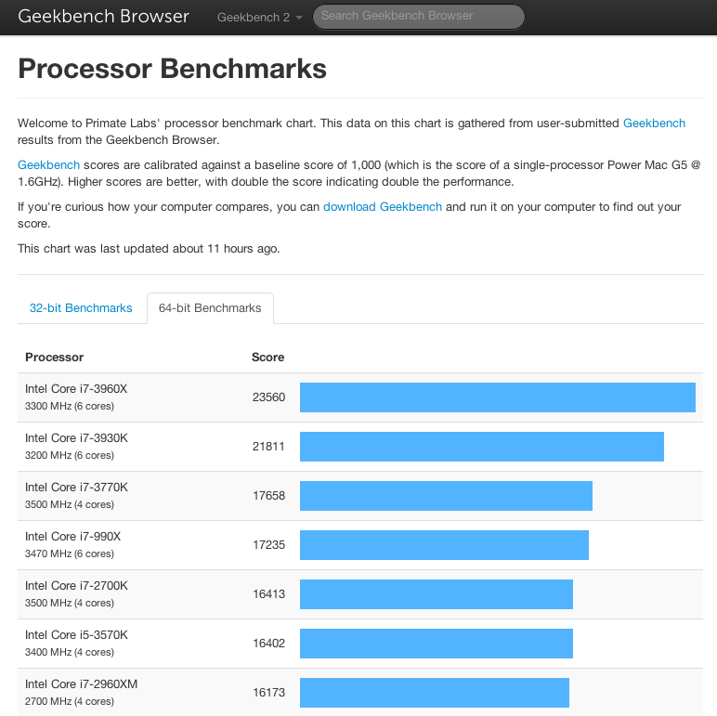
Other Popular Benchmarks
Several others popular
industry uses SPEC
but ordinary consumers use others
more representative of the work they do!
e.g., gaming, Photoshop/Aperture, copying huge files, multimedia coding/decoding, etc.
Geekbench is quite popular!

Slide 31
Amdahl’s Law
Possibly the most important law regarding computer performance:
Principle: Make the common case fast!
Eventually, performance gains will be limited by what cannot be improved
e.g., you can raise the highway speed limit, but the city speed limit stays the same

Slide 32
Amdahl’s Law: Example
Example: "Suppose a program runs in 100 seconds on a machine, where multiplies are executed 80% of the time. How much do we need to improve the speed of multiplication if we want the program to run 4 times faster?" How about making it 5 times faster?
25 = 80/r + 20 r = 16x
20 = 80/r + 20 r = ?

Slide 33
Example
Suppose we enhance a machine making all floating-point instructions run FIVE times faster. If the execution time of some benchmark before the floating-point enhancement is 10 seconds, what will the speedup be if only half of the 10 seconds is spent executing floating-point instructions?
We are looking for a benchmark to show off the new floating-point unit described above, and want the overall benchmark to show at least a speedup of 3. What percentage of the execution time would floating-point instructions have to account for in this program in order to yield our desired speedup on this benchmark?
5/5 + 5 = 6 Relative Perf = 10/6 = 1.67 x
100/3 = f/5 + (100 – f) = 100 – 4f/5 f = 83.33

Slide 34
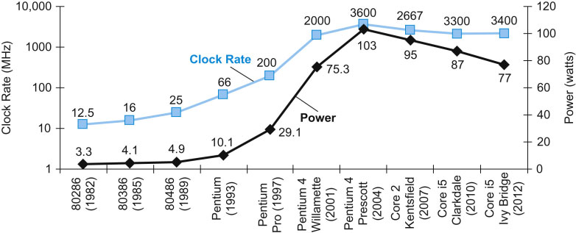
Power Trends
In CMOS IC technology
×30
5V → 1V
×1000

Slide 35
Reducing Power
Suppose a new CPU has
85% of capacitive load of old CPU
15% voltage and 15% frequency reduction
The power wall
We cannot reduce voltage further
We cannot remove more heat
How else can we improve performance?

Slide 36
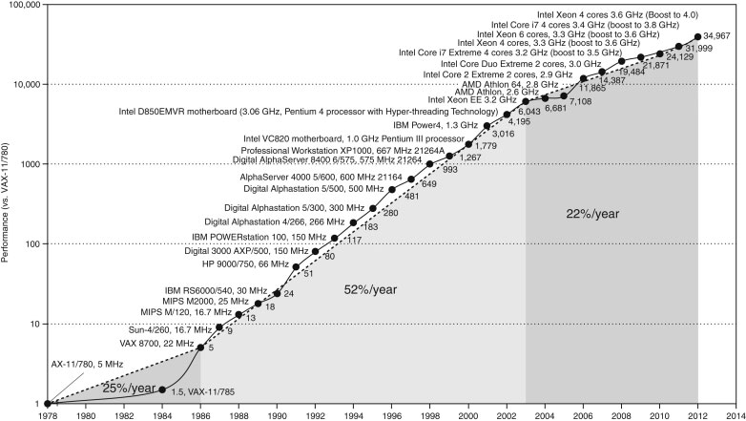
Moore’s Law: Uniprocessor Perf.
Constrained by power, instruction-level parallelism, memory latency

Slide 37
Multiprocessors
“Multicore” microprocessors
More than one processor core per chip
Requires explicitly parallel programming
Hardware executes multiple instructions at once
Ideally, hidden from the programmer
Hard to do
Programming for performance
Load balancing
Optimizing communication and synchronization
But, newer OSes and libraries have been designed for this

Slide 38
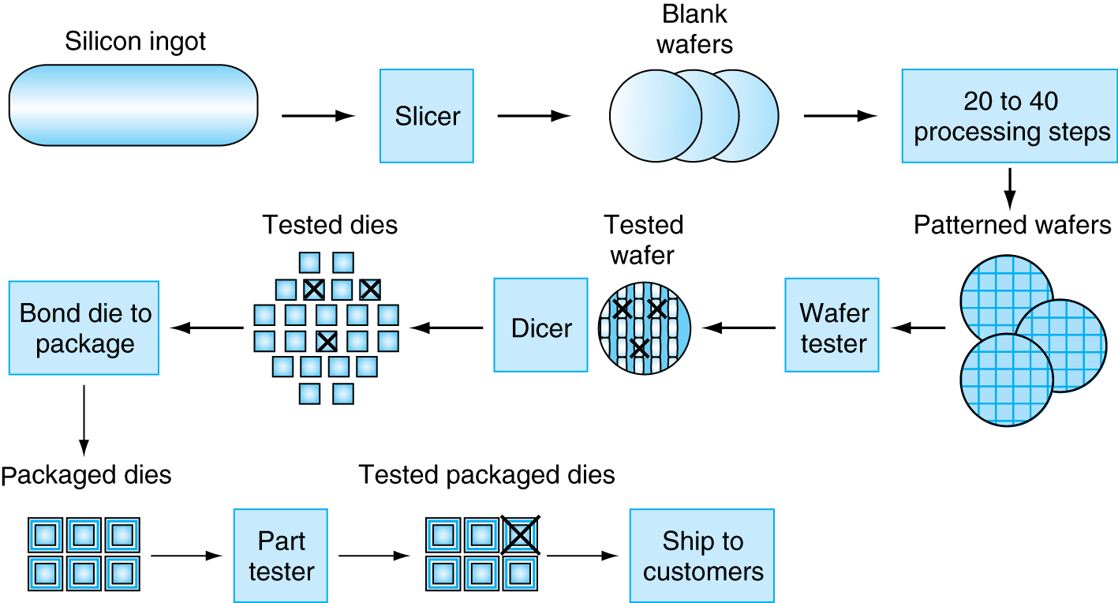
Manufacturing ICs
IC = Integrated Circuit (“chip”)
Yield: proportion of working dies per wafer

Slide 39
Integrated Circuit Cost
Nonlinear relation to area and defect rate
Wafer cost and area are fixed
Defect rate determined by manufacturing process
Die area determined by architecture and circuit design

Slide 40
Fallacy: Low Power at Idle
AMD X4 power benchmark:
At 100% load: 295W (max power)
At 50% load: 246W (83% max power)
At 10% load: 180W (still consumes 61% of max power)
Google data center
Mostly operates at 10% - 50% load
At 100% load less than 1% of the time
Industry challenge: Design processors to make power proportional to load

Slide 41
Remember
Performance is specific to a particular program
Total execution time is a consistent summary of performance
For a given architecture performance comes from:
increases in clock rate (without adverse CPI affects)
improvements in processor organization that lower CPI
compiler enhancements that lower CPI and/or instruction count
Pitfall: Expecting improvements in one aspect of a machine’s performance to affect the total performance
You should not always believe everything you read!
Read carefully! Especially what the business guys say!

Slide 42
Concluding Remarks
Cost/performance is improving
Due to underlying technology development
Hierarchical layers of abstraction
In both hardware and software
Instruction set architecture
The hardware/software interface
Execution time: the best performance measure
Power is a limiting factor
Use parallelism to improve performance

